Slide 1
Webinar Smart Contract Risk
Kennisgroep Keteninfomanagement
Sprekers: Michel Bernsen en Kees Schonebaum
7 maart 2024
Notes:
Klik om tekst toe te voegen

Slide 2



Contents
1. | Introduction | 10 min
2. | Blockchain explained | 10 min
3. | Smart contracts explained | 10 min
4. | Smart contract risks | 10 min
5. | Risk mitigation best practices | 10 min
6. | Q & A | 10 min
Sprekers
Kees Schonebaum
EY Digital Risk & Resilience
Michel Bernsen
EY Digital Risk & Resilience
NOREA werkgroep blockchain

Slide 3
Introduction
Promises and failures of the world changing emerging technology called blockchain

Slide 4
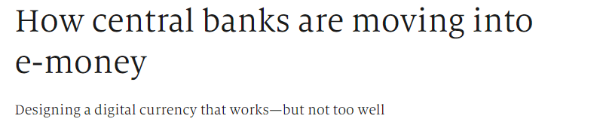

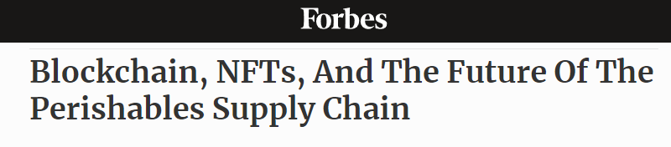

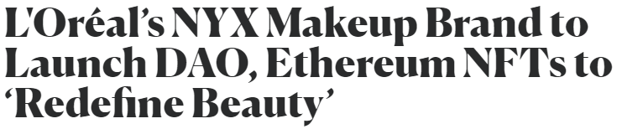

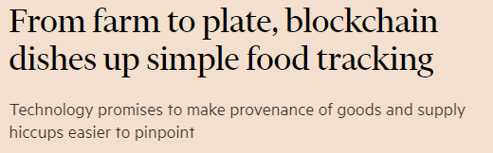

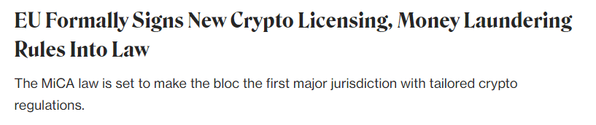
Enterprises and governmental bodies alike are captivated by the compelling benefits of blockchain technology.

Slide 5

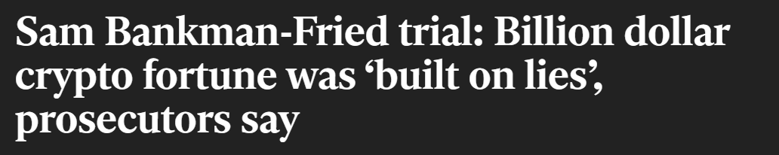

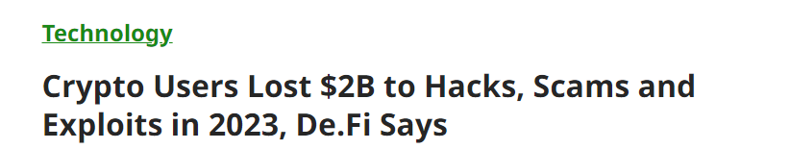

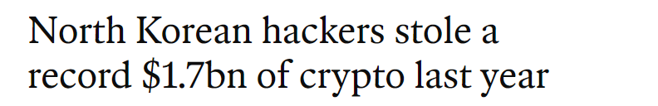

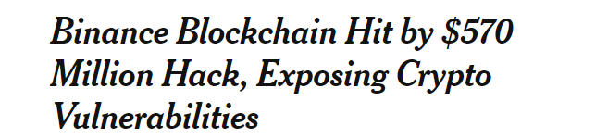

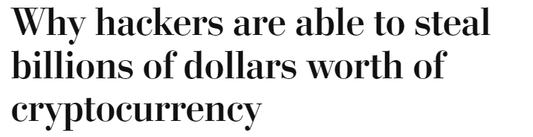
But there are also headlines suggesting that blockchain is a vulnerable technology ideal to be exploited by scammers.

Slide 6

So who is right?
WEF: 10% of worldwide GDP on blockchain in 2025
Gartner: Business value add 3.1 trillion in 2030
Where is the ‘Chat-GPT’ moment?
FTX impact – 152 billion dollar of funds are lost to worldwide customers
Cryptocurrencies are not the same as blockchain

Slide 7
Blockchain explained

Slide 8

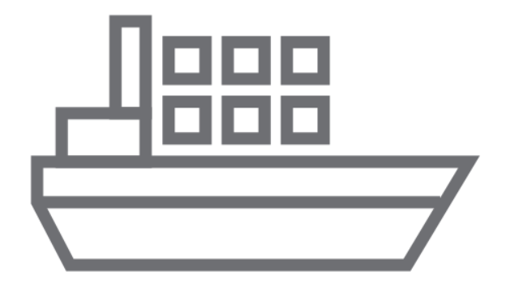
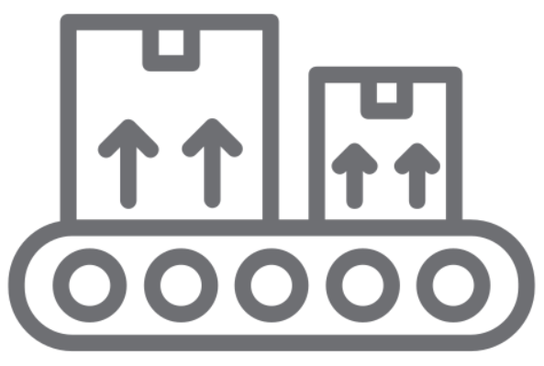
Blockchain is a decentralized digital ledger for recording and verifying transactions securely between participants
Participants often maintain their own separate ledgers to record orders and payments. Resulting in discrepancies, potential for errors, fraud, inefficiencies, and reliance on intermediaries due to each participant having their own version of truth.
A decentralized and shared ledger ensures a single version of the truth for all participants as the recorded history of transactions on this ledger cannot be altered.
Factory
Factory
Bank
Shipping
Bank
Shipping
Tax
Warehouse
Tax
Warehouse
Page 8

Slide 9





The definitions of Blockchain might differ but the core five building elements remain consistent
Asymmetric encryption
Digital signatures/ time stamping
Cryptographic hash functions
Consensus mechanism
Peer to peer network
Hash functions convert a piece of data into a fixed size string of characters. This string is unique to the piece of data that was used.as input
This form of encryption enable the use of public and a private key. This way users have a secure way to decrypt data send to them.
Due to digital signatures and time stamping it is impossible to double spend on the blockchain, and enables everyone to verify data.
Mathematical process by which blocks of transactions are validated and appended to the chain ensuring all nodes agree and reflect the same copy of the ledger
An electronic communication platform made up of computers called “nodes” with identical versions of the distributed ledger
So, what is blockchain?
immutable
database
transacting and recording data
and value
Distributed ledger
and
for
very
securely

Slide 10







How does a blockchain transaction work?
Blockchain is a way to record and store data:
- Real time shared database
- Validated by all nodes
- Secure due to consensus
- Hashing ensures immutability
Transaction origination
Node validation
Blockchain formulation
User initiates transaction
User uses keys to verify identity
The transaction is digitally signed to provide immutability
Transaction data, including sender and recipient’s public keys, is distributed across the network
If a majority of nodes verify the transaction as legitimate, transaction data is packaged into a block
Block is hashed and added to the chain using a predetermined consensus protocol
All node ledgers are updated to include new block in the chain
Contains:
- Hash of previous block
- Time stamp
- - Transaction data

Slide 11
Blockchain Risk Universe
Ledger Integrity
• Asynchronization of nodes
• Compromised network security
• Unverified timestamps
Smart Contracts
Network Security
rd_{party external inputs}
• Undetected losses
• Malicious 3
• Vulnerable network components
• Weak security protocols
• Premature or latent transactions
• Reentrancy risk
• Cyber attacks
• Delegate-call injections
• Unauthorized and malicious activities
• Denial of Services
Regulatory Compliance
• Regulations
Consensus Mechanism
• Bypass methods
• Jurisdictions
• Lack of SOD among nodes
• Unauthorized consensus-
• KYC & AML
• MICA
approved forks
Capacity & Availability
Data Integrity
Blockchain
Risk
Universe
• Inefficient scaling and poor capacity mngnt.
• Poor consensus transmission size and speed
• Inefficient block size and depth
• Unconfirmed and orphan transactions
• Manipulation of transaction timestamps
• Compromises of network
Blockchain Risk
Universe
• Fraud attempts
Transaction Authorization
• Node attacks
Centralization of Power
• Transaction manipulations
• Invalid or fraudulent asset deletions
• Inappropriate usage of Hashing
power/resources
• Front-running transactions
Energy Consumption
• Inefficient usage of energy recourses
• Sustainability problems due to high
• Hash Collision Attacks
3
rd_{Party Integration}
energy consumption
• Corrupt a peer-to-peer network
• Anti-pattern attacks
Key Security
• Loss of assets
• Unauthorized transactions
• Fake node attacks
Algorithm Mechanism
• Cybersecurity attacks
• Fraud and swapping attacks
• Swapping attacks
• Border gateway protocol hijacking
• Undefined authorized block signers
• Stolen computing resources and
• Key manipulation
assets

Slide 12
Smart Contracts explained

Slide 13
What are smart contracts and how do they work?
Definition 1 (Szabo, 1992):
A smart contract is a computerized transaction protocol that executes the terms of a contract. The general objectives of the smart contract design are to satisfy common contractual conditions (such as payment terms, liens, confidentiality and even enforcement), minimize exceptions both malicious and accidental, and minimize the need for arbitration and enforcement costs, and other transaction costs.
Definition 2 (Lee, 2023):
A smart contract is essentially an application residing on the blockchain that can write values onto the blockchain itself. As all the data recorded on the blockchain are immutable and traceable, smart contracts allow you to make use of blockchains as a backing store for storing data that are permanent so that you can use it as a form of proof later on.
What is the scope?
Over 2,5 million smart contracts
Total Value Locked 148 billion USD

Slide 14
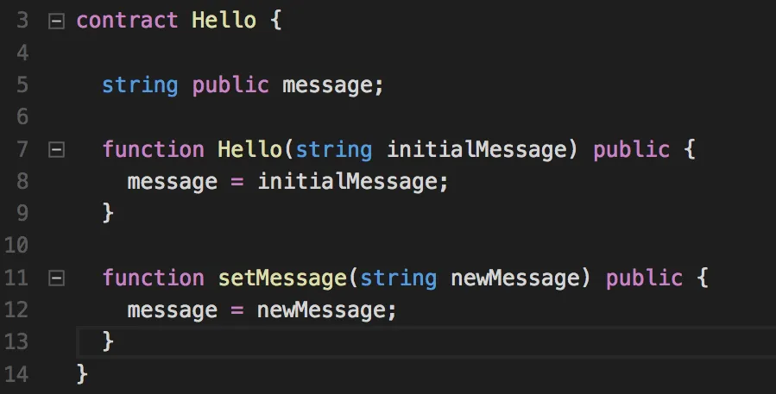
Foundations of smart contracts
Smart contracts run on a blockchain, meaning that once uploaded they can not be removed (testing is more important, first time right)
Smart contracts have an address that you use to interact with it
Smart contracts are not that smart, Oracles are their eyes and ears
Smart contracts are just a piece of code that are developed in a certain language

Slide 15




Example of a smart contract
Smart contracts can be used to automatically reimburse passengers of delayed flights.
Considering how smart contracts execute a set of rules, the only thing you need is the defined parameters that conclude how many hours are considered to be enough to be reimbursed as passenger.
If you take two hours as a minimum, a simple smart contract could reimburse passengers following the ‘if, then’ logic (if flight is delayed two hours, then passengers are reimbursed).
$

Slide 16
Change management
Can you delete a smart contract?
Can you make changes to a smart contract?

Slide 17
Smart Contract Risks

Slide 18
Fundamental risks
  Applicable risks with the use of smart contract
  Security
  Functionality
  Quality
  Efficiency
  Business Processes
  Web Application
  Smart Contracts
Attackers are using existing smart contracts functionality in order to execute attacks
  Blockchain
  Network
  Physical

Slide 19
Risks materialized
Poly Network hack – 611 Million USD - 2021
Ethereum hack – 3,6 million Ether (10b atm) - 2016
YAM Finance – 65 million USD – 2020
Parity Wallet - 150 million USD - 2020
Typos – 36 Million USD
Infinitive loop bug - 300.000 USD

Slide 20
Risk mitigation best practices

Slide 21
Testing, auditing & secure development
  Automated Testing
  Smart Contract Audits
  Peer Review
  Follow established patterns
  Limit Complexity
Other best practices
  Bug Bounties
  Time Locks
  Multi-signature Wallets
  Upgradable Contracts

Slide 22


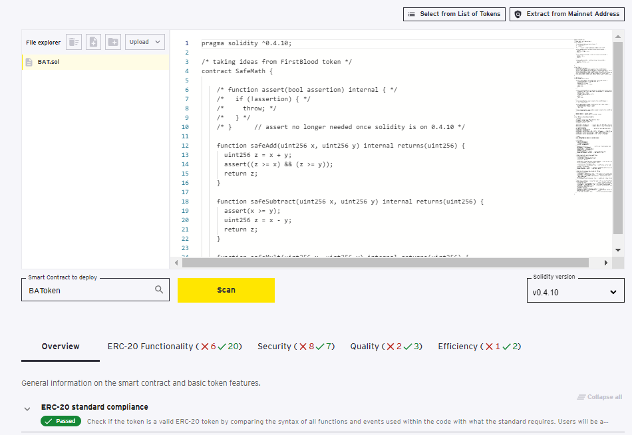

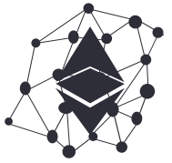
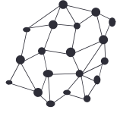
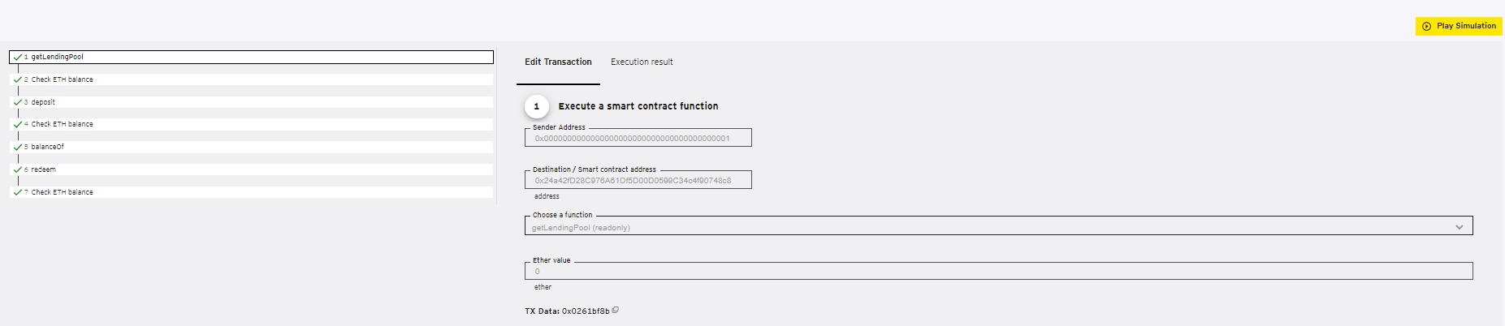
Smart Contract & Token Review
The EY smart contract review application automates the assessment process of a smart contract by running hundreds of tests using static and dynamic code analysis methods. Test results are accompanied by technical, yet easy to understand, descriptions and examples.
Automated
Simulator
Users provide source code
or
Import contract address from the Ethereum mainnet
Security and quality testing for all contract types
Business logic testing for specific EVM-based tokens
Virtual machine allows users to run different parameters, test edge cases and mass transactions
EVM simulator
EVM simulator
Ethereum mainnet
Reporting
Developer review

Slide 23
Q & A

Slide 24
Bedankt
Voor meer informatie kun je contact opnemen met de Kennisgroep Keteninfomanagement via
Christel Maas
088-4960361
c.maas@norea.nl
7 maart 2024
Notes:
Klik om tekst toe te voegen

